Slide 1
დამატებითი ამოცანები

Slide 3
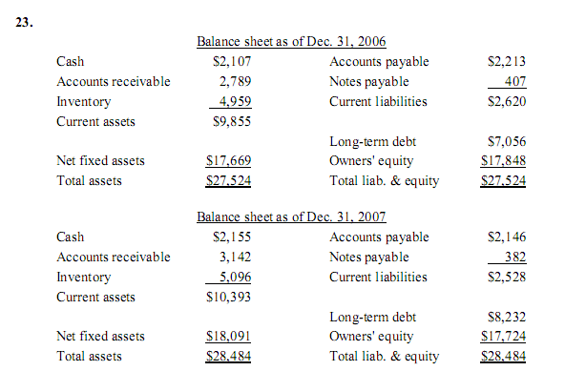
Chapter 2: Problems 23 and 24

Slide 4
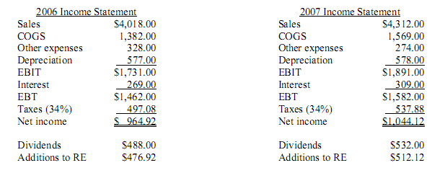
Chapter 2: Problems 23 and 24

Slide 5
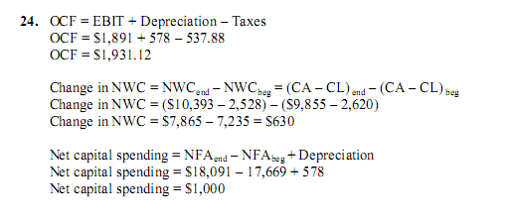
Chapter 2: Problems 23 and 24

Slide 6
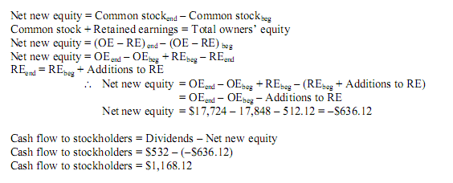
Chapter 2: Problems 23 and 24

Slide 7
Chapter 3: Problem 9

Slide 8
Chapter 3: Problem 9

Slide 9
Chapter 3: Problem 9
b)
c)

Slide 10
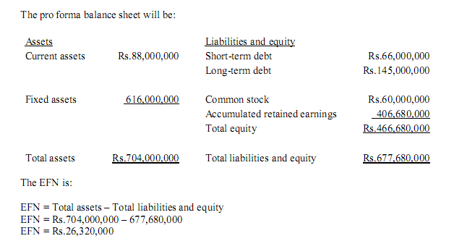
Chapter 3: Problem 9

